Slide 1


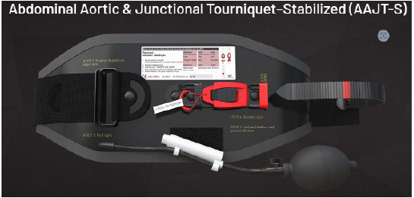

Junctional Tourniquet

Slide 2


Junctional Tourniquet
AAJT-S

Slide 3
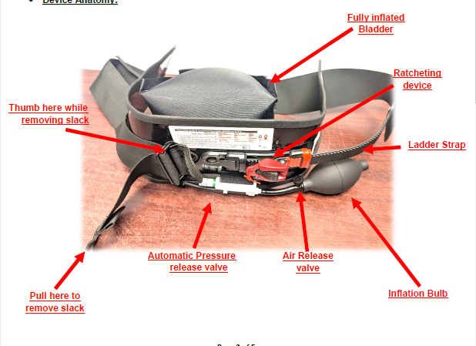
Junctional Tourniquet
AAJT-S

Slide 4
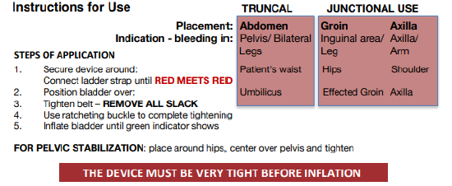
Junctional Tourniquet
AAJT-S

Slide 5
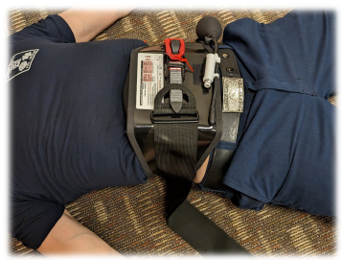
Junctional Tourniquet
AAJT-S
Abdominal Application:
Position over umbilicus
Secure device
Inflate bladder

Slide 6
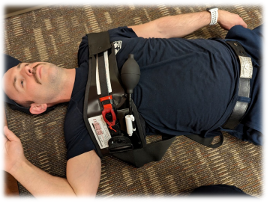
Junctional Tourniquet
AAJT-S
Axilla Application:
Position high in axilla with tension band over the opposite arm
Secure device
Inflate bladder

Slide 7
Junctional Tourniquet
AAJT-S
Inguinal Application:
Position over umbilicus
Secure device
Inflate bladder

Slide 8
Junctional Tourniquet
AAJT-S
Pelvic Fracture Stabilization Application:
Position over pelvis, passing over the hips
Secure device
Do NOT
Inflate bladder

Slide 9


Junctional Tourniquet
AAJT-S

Slide 10
Junctional Tourniquet AAJT-S
Questions?

